Slide 1
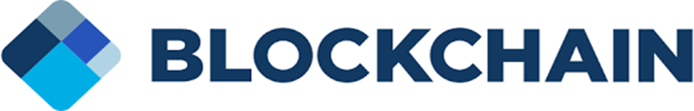

Prospects of Blockchain
Sriram
Technology of Trust

Slide 2
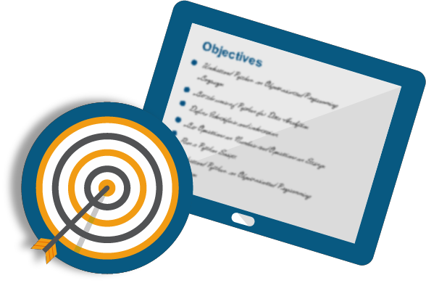
Course Objectives
After completing this module, you should be able to:
Blockchain Use Cases

Slide 3
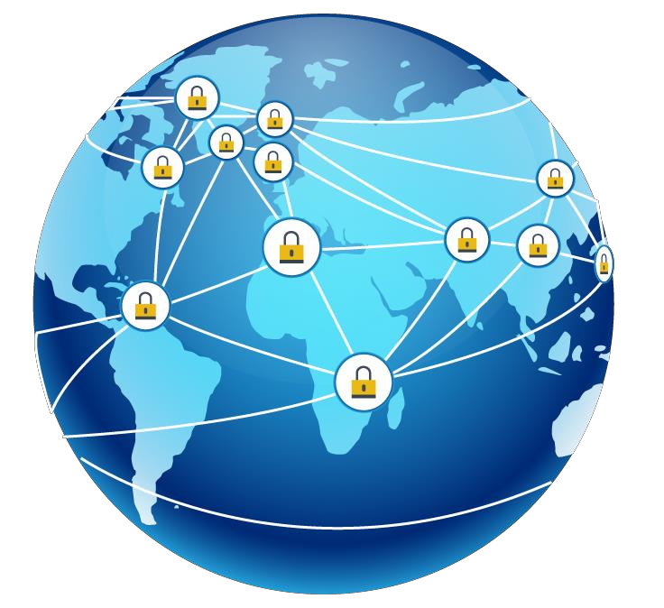



How Blockchain will Revolutionize our World?
With blockchain, for the first time, we have a new digital medium for value where anyone can access anything of value even things like identity and votes can be moved, stored and managed securely and privately
Through the blockchain, we can go from redistributing wealth to distributing value and opportunity fairly in the first place, from cradle to grave
This can be done by protecting rights through immutable
records like land titles, creating a true sharing economy
The world of infinite possibilities

Slide 4


Blockchain Use Cases

Slide 5
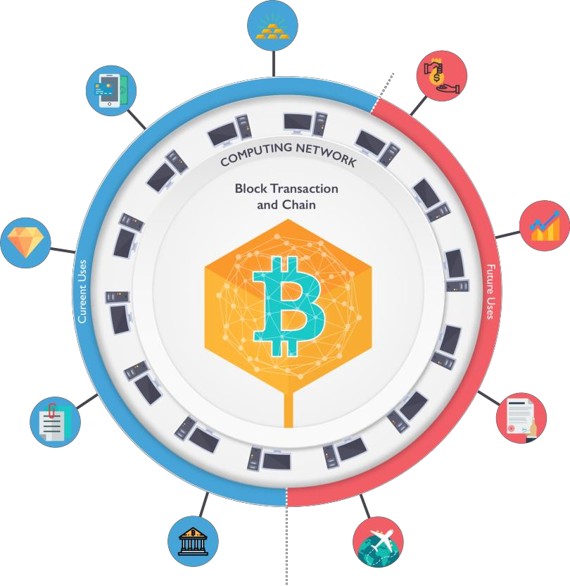
Selected Potential Blockchain Use Cases
Gold
Example: Real Asset co. in London
Example: MeXBT in Mexico city
provides a web-based app
Remittances
Syndicated Loans Example: Digital Asset
Holdings, Master’s firm
Private Shares
Example: NASDAQ is developing a blockchain based system
Example: London start-up
Everledger uses 4.0
Diamonds
Example: Factom based in Austin, Texas is building a Land title registry
Property titles/Land
records
US Treasury Repos
Example: NASDAQ is developing a blockchain based system
Example: London based Earthport and Ripple labs a Sanfransisco based start-up
Interbank Payments
Airline Miles
Example: Chain, a San Francisco Firm, offers software tools for developers

Slide 6

Various Use Cases of Blockchain
Let’s Unveil The Potential Of Blockchain Technology By Discussing Its Practical Use Cases

Slide 7



Use Case: Proof of Existence
Demonstrating data ownership without revealing actual data
You can publicly reveal the digest and if conflict arises you can prove you had the data that generates the digest
Document timestamping You can prove certain data exists at a certain moment of time
Proof of Existence
Checking for document integrity
Gives you the security that certified data can't be changed

Slide 8
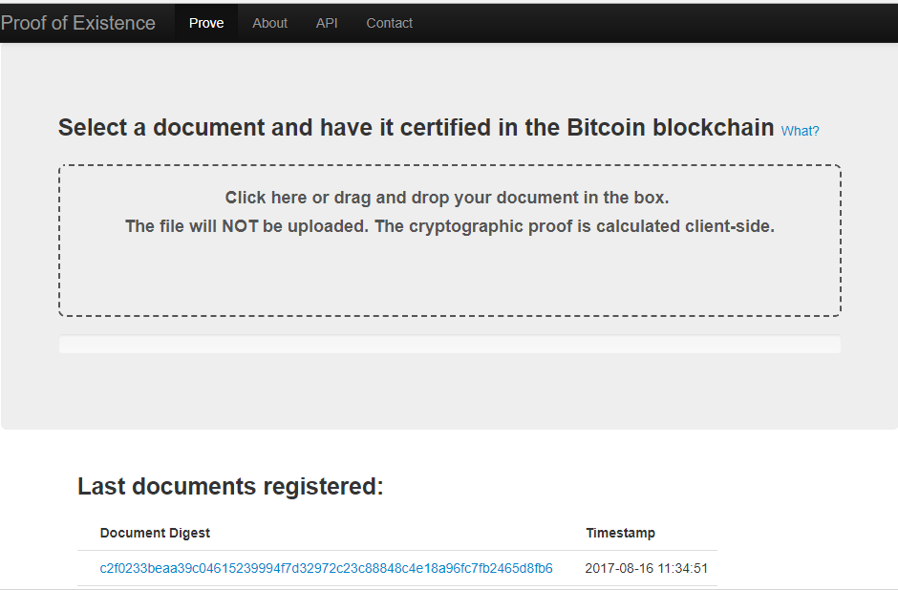
Proof Of Existence

Slide 9
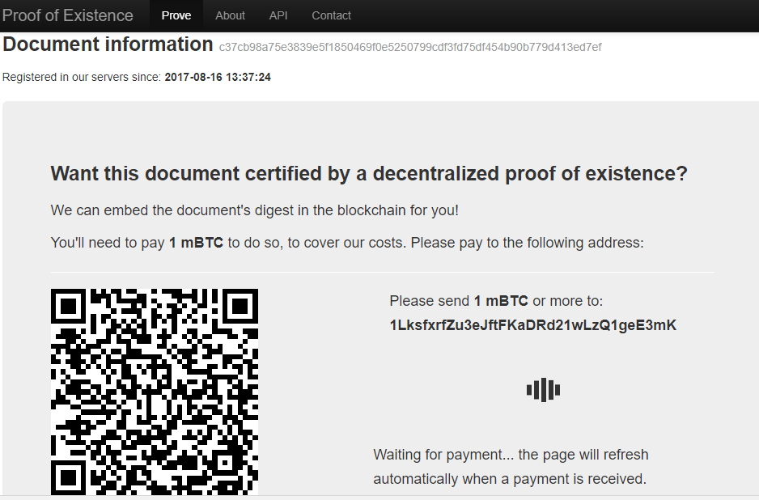
Proof of Existence

Slide 10
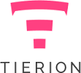
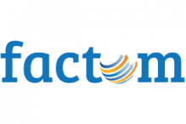
Use Case: Record Keeping
Data embedded and hashed into secure blockchains like Bitcoin create immutable and unforgeable data
Projects like Tierion use the Bitcoin blockchain to
create “blockchain receipts”
All data can be verified through the Bitcoin blockchain without the need to trust a third party
Factom is a similar project that also verifies and hashes data into Bitcoin’s blockchain

Slide 11
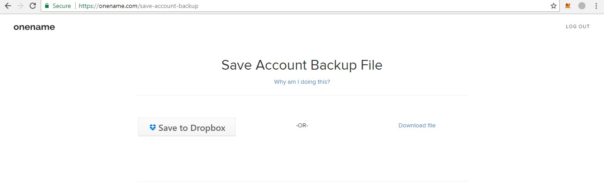
Use Case: Identity
Onename is a New York based start-up that has created an ID system using the Bitcoin blockchain
Its first service allows users to create blockchain IDs, which will soon be used to login to websites without
the need for a password

Slide 12
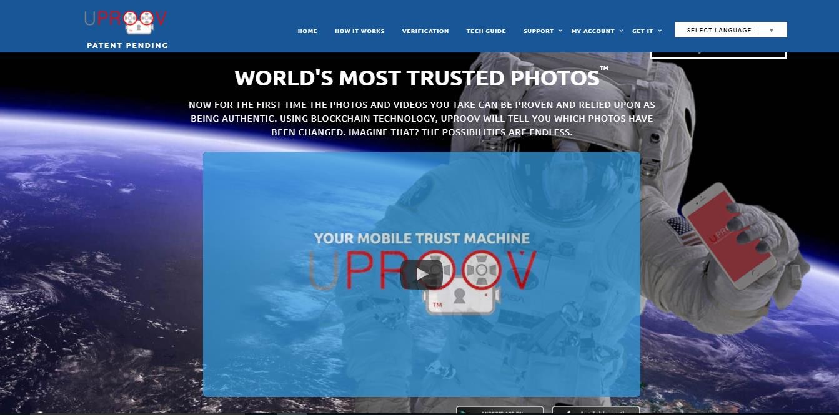
Use Case: UPROOV

Slide 13



UPROOV- Your Mobile Trust Machine
“You Prove” instantly proves any photos, videos or sound recordings using our simple world first App
01
Data on recordings taken with Uproov are stamped into the Blockchain Ledger, which the Economist calls the Trust machine
02
Uproov removes any doubt or dispute about yours or others images, it time stamps to the nearest second and cannot be edited
03

Slide 14
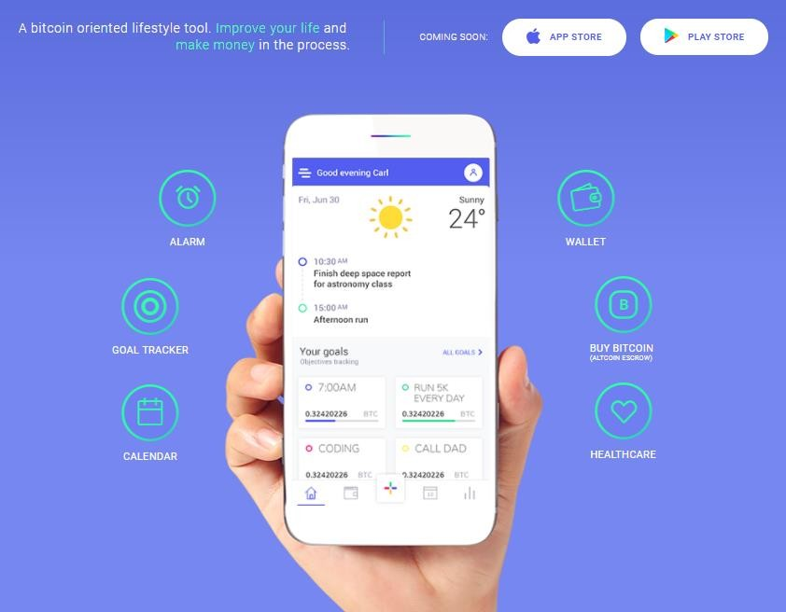
Use Case: Smart Alarm DApp
Betternot.rest, a smart alarm clock DApp, powered by Syscoin’s smart contracts platform, challenges you to improve your wake-up routine and earn some money in the process

Slide 15
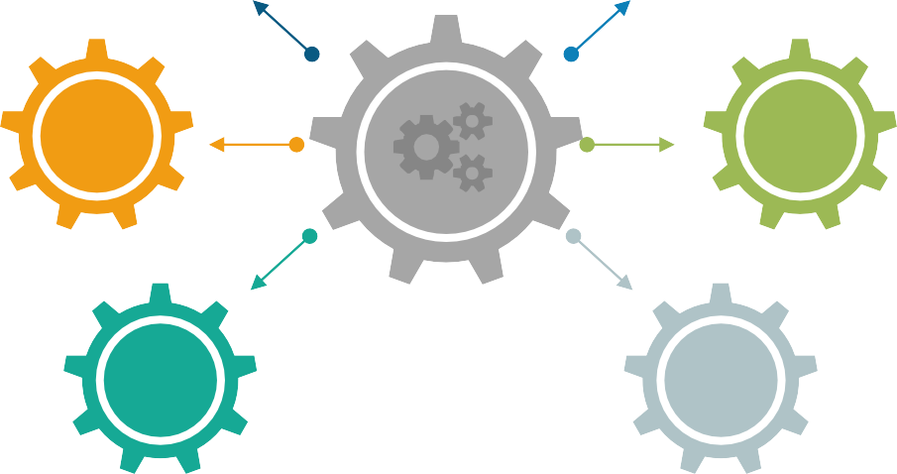
Smart Alarm DApp: How it works
First, every user deposits some Bitcoins to their app
account
By the end of each month, all the funds, that the sleepy users have lost, are pooled together
1
4
Before going to sleep, they make a commitment to wake up at a certain time or lose a certain amount
of their money
Then, 90 percent of that money is redistributed back to those who have managed to meet their commitments and wake up on time throughout the month
2
5
If a user fails to get up on time and confirm it with the app, their funds are claimed
by the system
.
3
6
In a nutshell, the app is closely integrated with Syscoin and its Blockchain and is governed by smart contracts

Slide 16
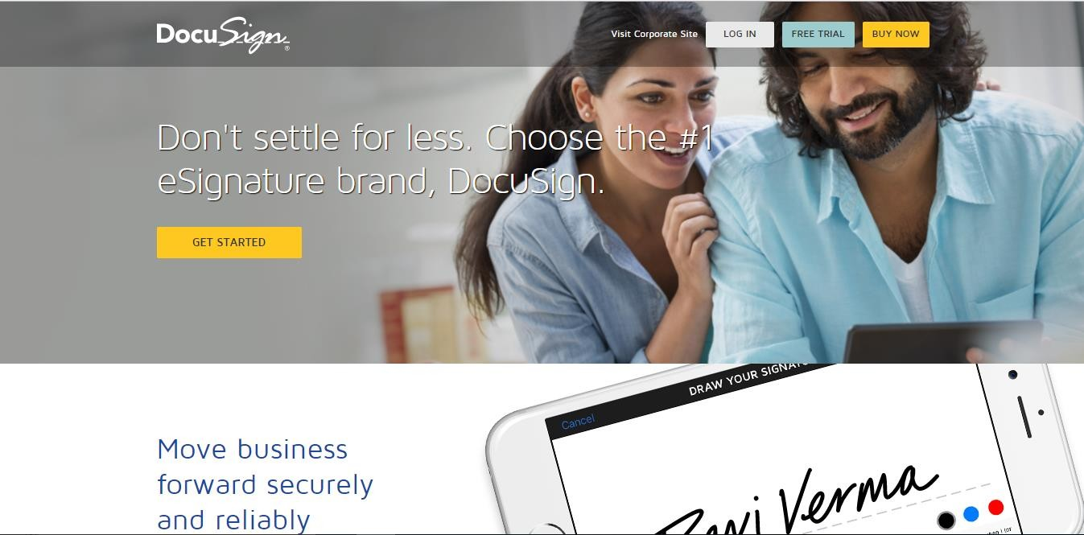
Use Case: Car Leasing and Sales- DocuSign

Slide 17
Car Leasing and Sales: DocuSign(Contd…)
1
2
3
4
To begin the process, a prospective customer chooses the car they want to lease after test- driving, evaluating their options, and completing any pre-approvals
That car’s identity is then registered on the Bitcoin Blockchain – the secure ledger database used to record transactions over broadly- distributed computer networks
From the driver’s seat, the customer then chooses the lease options for the car – low, mid or high mileage, for example and DocuSigns the leasing contract right there and then
This is all in turn updated on the Blockchain

Slide 18
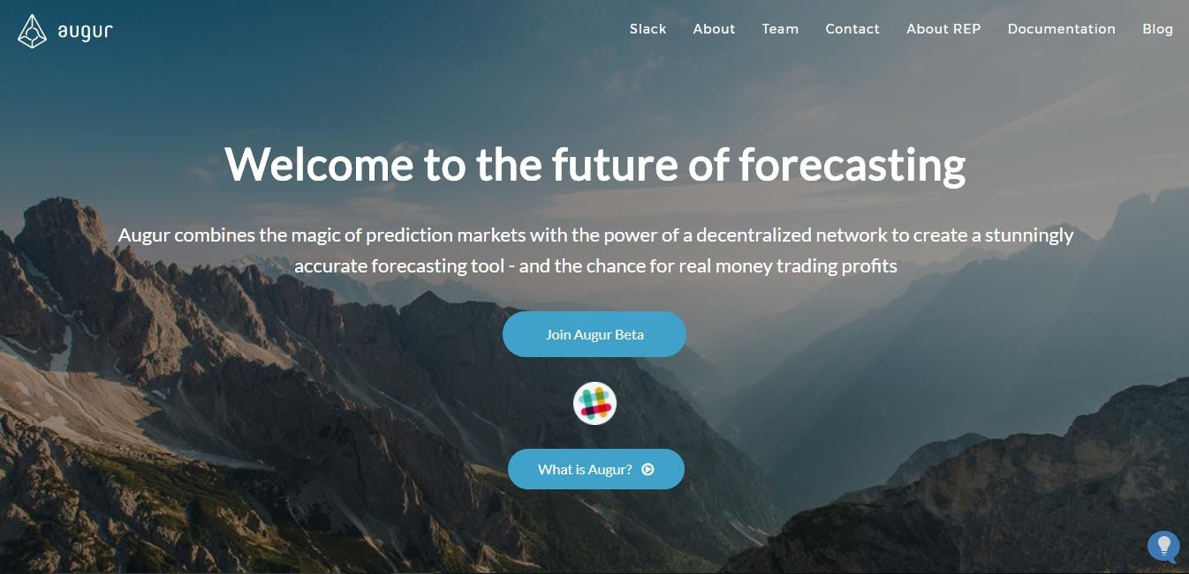
Use Case: Forecasting- Augur

Slide 19
Augur
The online crowd-funded platform Augur hopes to capitalize on decentralized prediction markets
Augur is built on the
Ethereum blockchain
It will not only offer users a place to place bets on sports and stocks, but on other topics such as elections and natural disasters
The company says it will offer a service that looks like a normal betting exchange
The idea is to go beyond sports gambling and create a “predictions market”

Slide 20
Use Case: Online Music- Problems
Owning it
No comprehensive database of music copyright ownership exists
Getting paid
Listeners can access tracks immediately with a click, yet it can take years for royalties to reach those responsible for making the music
Shining light into black boxes
The mechanism by which royalties are calculated and paid is often opaque. Some revenue ends beyond the
reach of the artists and songwriters

Slide 21
Online Music: Solution
Recently, a number of music industry projects have turned to Blockchain technology as a possible solution to these problems
These include Mycelia, launched by singer, songwriter and producer Imogen Heap, and Dot Blockchain
Music, launched by PledgeMusic founder Benji Rogers
Then there’s Ujo Music, Blokur, Aurovine, Resonate, Peertracks, Stem and Bittunes, which already claims users in 70 countries

Slide 22








Use Case: Cloud Storage
A cooperative storage cloud is a decentralized model of networked online storage where data is stored on multiple computers (nodes), hosted by the participants cooperating in the cloud
Problem
Enterprises that offer cloud storage often secure customers’ data in a centralized server which can mean increased network vulnerability from attacks by hackers
Solution
Blockchain cloud storage solutions allow storage to be decentralized, and therefore less prone to attacks that can cause systemic damage and widespread data loss

Slide 23
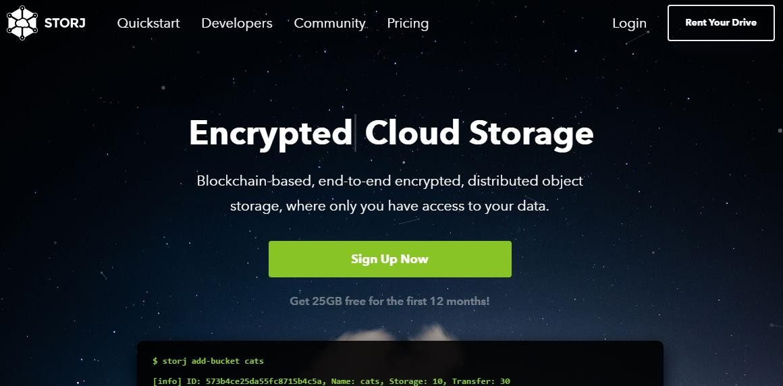
STORJ: Decentralized Cloud Storage
Storj is like an internet
filesystem
Data blocks are encrypted and distributed across a globally distributed set of storage nodes using block-chain algorithm

Slide 24

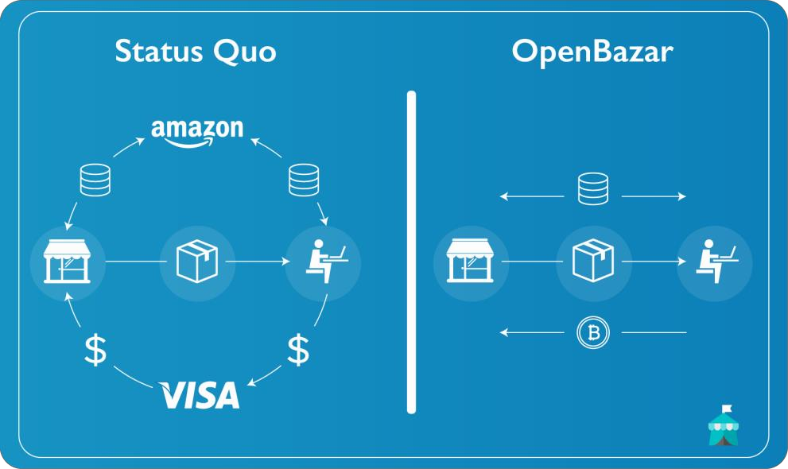



Use Case: Retail- OpenBazaar
OpenBazaar uses peer to peer network wherein you download and install a program on your computer that directly connects you to other people looking to buy and sell goods and services with you
It's like buying or selling with someone in person - except you're online

Slide 25
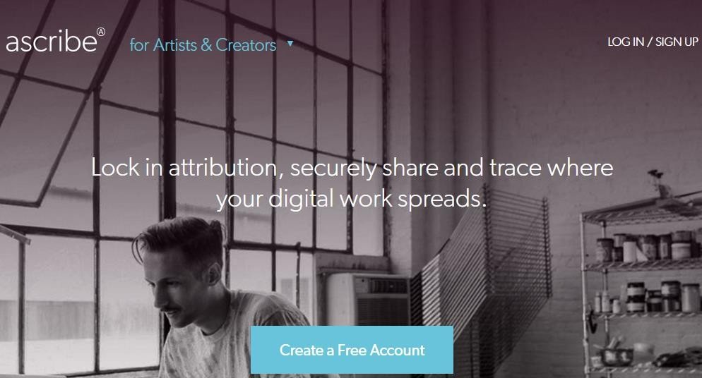
Use Case: Ascribe(Secure your Work)

Slide 26
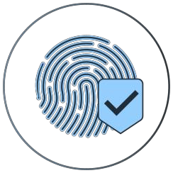
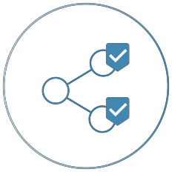
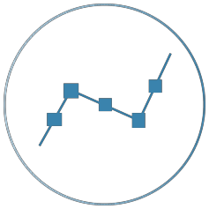
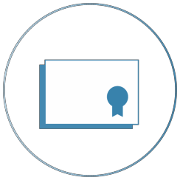
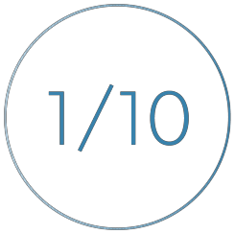
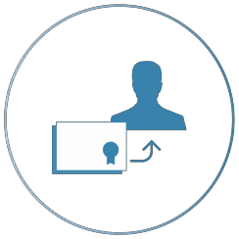
Ascribe Provides Following Features
Lock In Attribution
Create a permanent and unbreakable link between you and your creative work. That link – the record of ownership – can be forever verified and tracked
Securely Share
Securely share your digital content with friends, family or fans
Gain Visibility
Trace where and how your work spreads on the Internet. We show you all the sites your work has appeared on and its growth over time
Certificate Of Authenticity
Each registered piece comes with a COA, a built in unique cryptographic ID and the complete ownership history
Limited Digital Editions
Unique digital editions make it possible to own and transfer digital artwork just like you can with physical art
License Your Work
Transfer, consign or loan your digital creations without losing attribution. The platform is equipped with clear legal framework

Slide 27
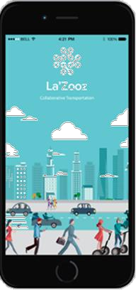
Use Case: Ride Sharing
01
It makes its own proprietary digital currency
02
People use La’Zooz by finding other people traveling similar routes and exchanging coins for the rides
03
These coins can then be used for future rides
04
Users earn (or “mine”) these coins by letting the app track their locations

Slide 28
Use Case: Supply Chain Management
Supply chains are basically a series of transaction nodes that link to move products from point A to the point-of- sale or final deployment
With blockchain, as products change hands across a supply chain from manufacture to sale, the transactions can be documented in a permanent decentralized record — reducing time delays, added costs, and human errors
Provenance is building a traceability system for materials and products
Hijro offers an alternative platform for lending into global supply chains
Skuchain builds blockchain-based products for the business- to-business trade and supply-chain finance market

Slide 29
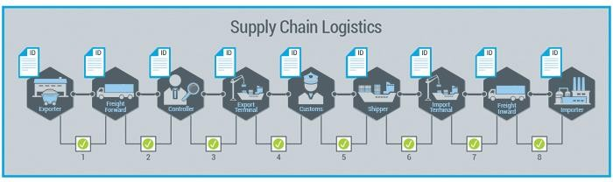
Supply Chain Management- Example
Right from issuance of the Letter of Credit to the final payment, distributed ledger provides the much needed transparency & efficiency in the otherwise manual process flow
Supply Chain in Trade Finance

Slide 30

So far we have seen some the useful practical applications of Blockchain. Let’s now see how Blockchain can be used with IOT

Slide 31
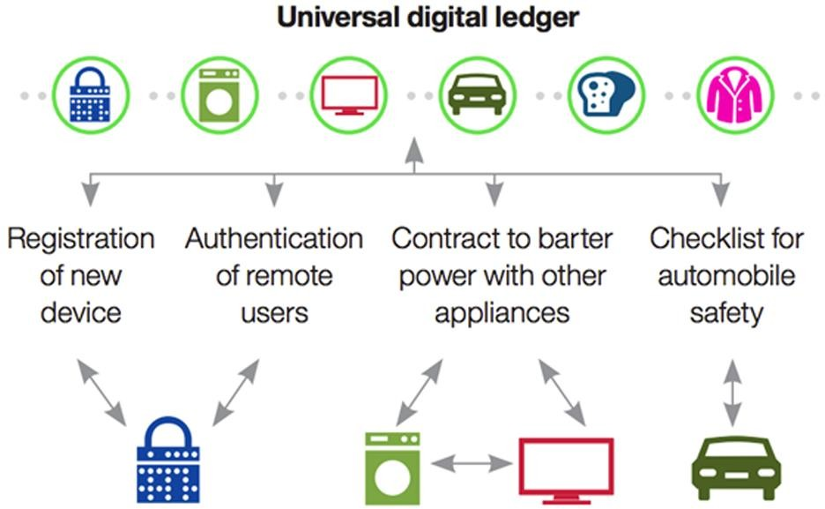
Blockchain and IOT

Slide 32

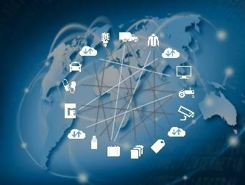
Autonomous Decentralized Peer-to-Peer Telemetry
IBM and Samsung have been working on a concept known as ADEPT
With ADEPT, a blockchain would serve as a public ledger for
devices to mediate communication between them
The devices would be able to communicate with one another autonomously to manage software updates, bugs, or energy management

Slide 33
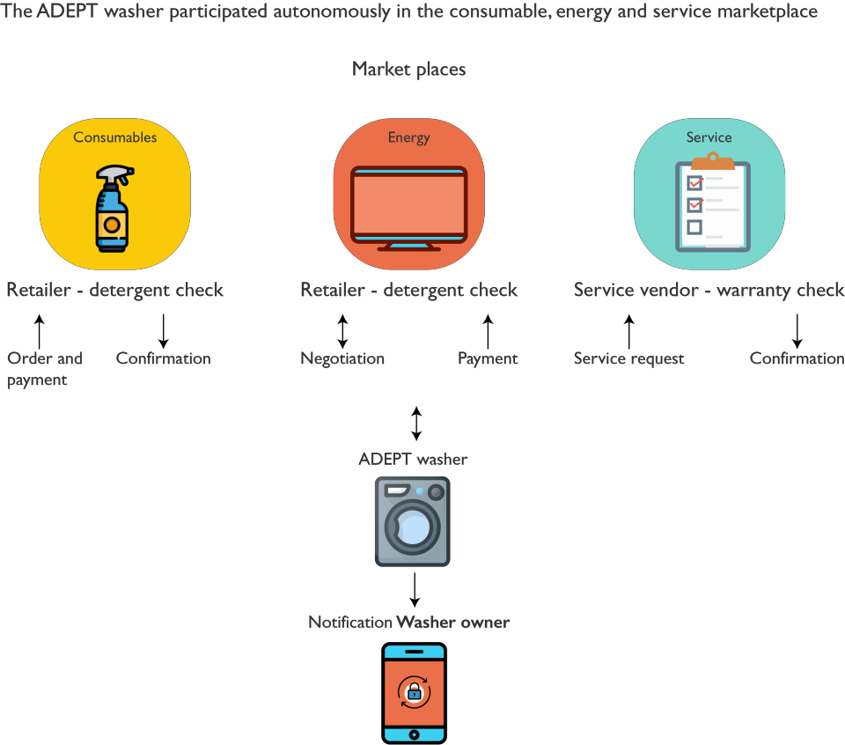
The ADEPT Use Case

Slide 34
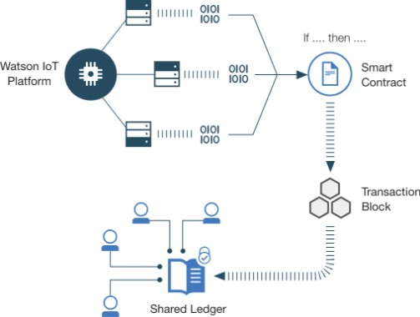
IBM Watson IOT
Enables IoT devices to send data to private blockchain ledgers for inclusion in shared transactions with tamper resistant records
Blockchain’s distributed replication allows your business partners to access and supply IoT data
All business partners can verify each transaction, each partner is held accountable for their individual roles in the overall transaction

Slide 35
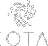
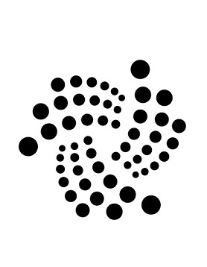
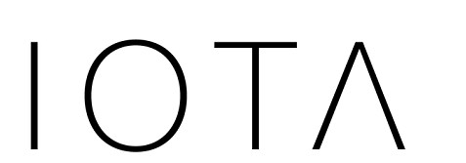
IOTA
A revolutionary new transactional settlement and data integrity layer for IOT
Based on a new distributed ledger architecture, the Tangle, which introduces a new way of reaching consensus in a decentralized peer-to-peer system
Even infinitesimally small Nano payments can be made through IOTA
It’s the missing puzzle piece for the Machine Economy to fully emerge and reach its desired potential

Slide 36
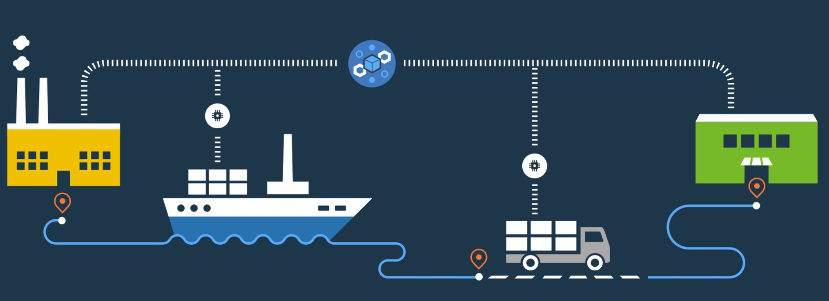
Freight Transportation
Moving freight is a complex process involving different parties with different priorities
An IoT-enabled blockchain can store the temperatures, position, arrival times, and status of shipping
containers as they move through the system
Indelible blockchain transactions ensure that all parties can trust the data and take action to move the product quickly and efficiently

Slide 37
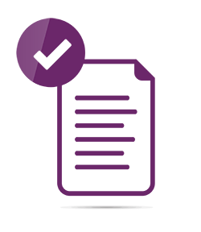
Log Operational Maintenance Data
IoT devices track the state of safety critical machines and their maintenance in your organization. From aircraft engines to elevators
Blockchain provides for a tamper free ledger of the operational data and the resulting maintenance
Third party repair partners can monitor the blockchain for preventative maintenance and record their work back on the blockchain
Operational records can also be shared with government entities to verify compliance.

Slide 38
Let’s now consider blockchain use cases in healthcare

Slide 39

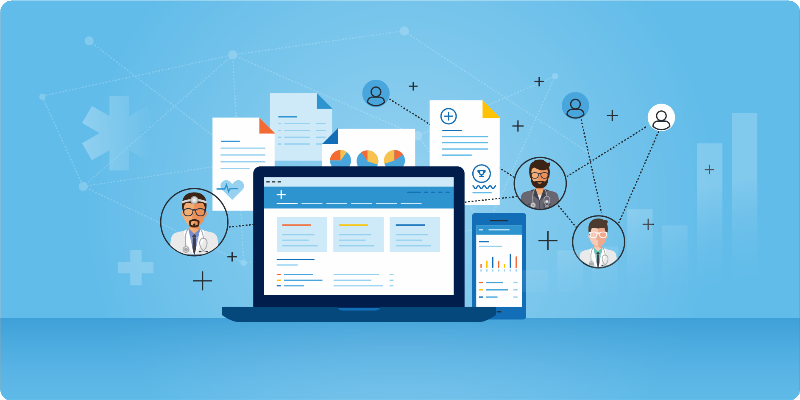
Blockchain Use Cases in Healthcare

Slide 40
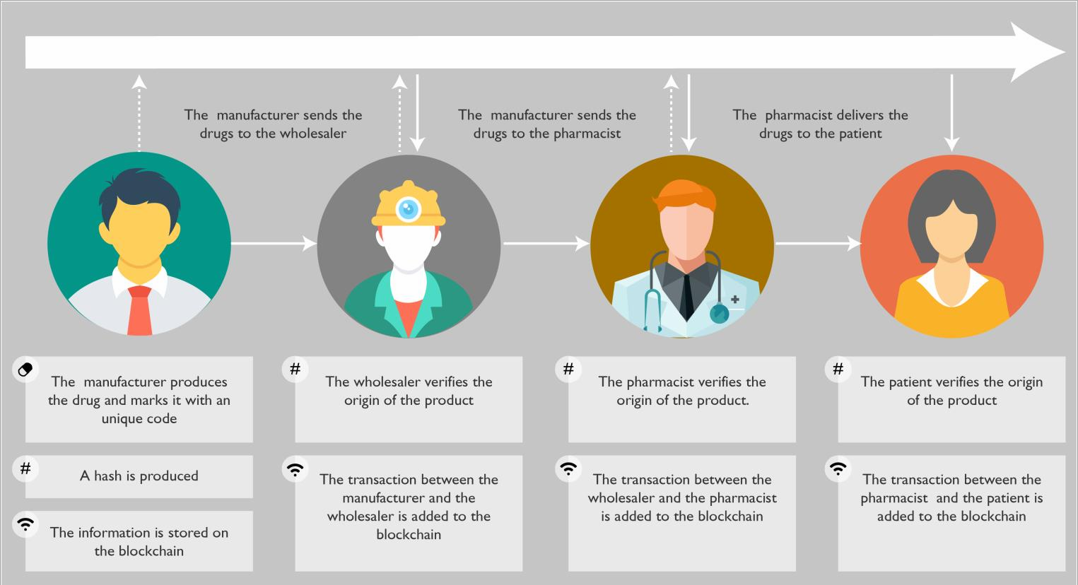
Use Case 1: Drug Traceability

Slide 41
Use Case 2: Clinical Trials: Problems
During clinical trials, a considerable amount of data is produced – safety and quality reports, statistics, blood tests, surveys, medical imagery – and large groups of people are involved, making it hard to track and control everyone
Hence, mistakes can be committed along the way, some unintentionally and others not
Fraud usually includes modifying or hiding data that could compromise the advance of the clinical trial and damage the image of an organization among regulatory agencies or patients

Slide 42
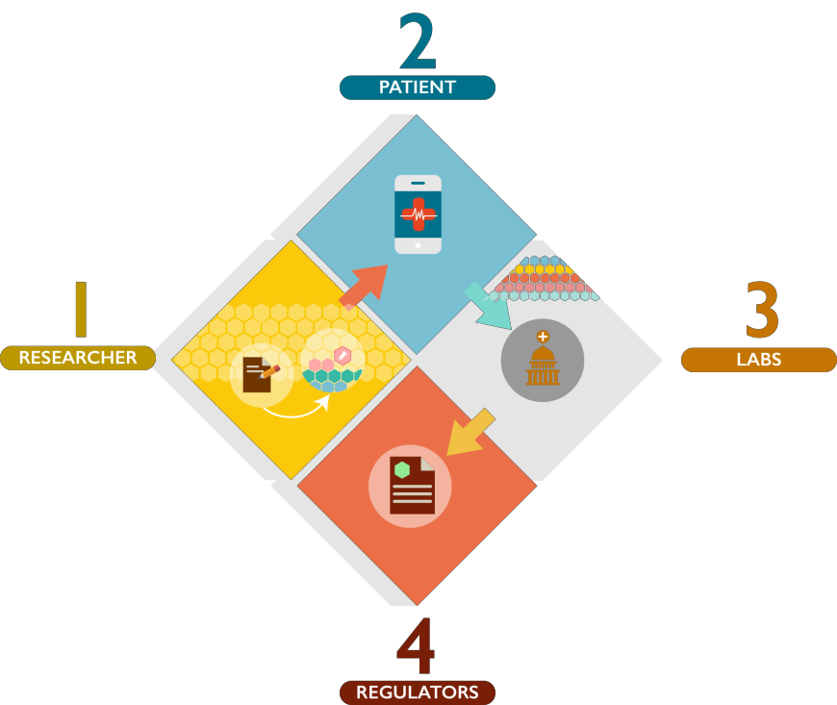
Use Case 2: Clinical Trials: Solution
Digital Notarization of study design
The original design and methodology of the trial and its objectives are recorded and notarized in the blockchain
01
Title Patient Consent Notarization
The investigator must obtain free and informed consent from the patient
02
Title Fulfillment and Notarization of Surveys The Patients fill out surveys which are signed and cryptographically notarized into the blockchain, providing a timestamped recorded of the collection of all results
03
Clinical Trial Audit
With the access to the proofs of the existence of the information, regulators and other researchers can verify the integrity and authenticity of the data and study
04

Slide 43
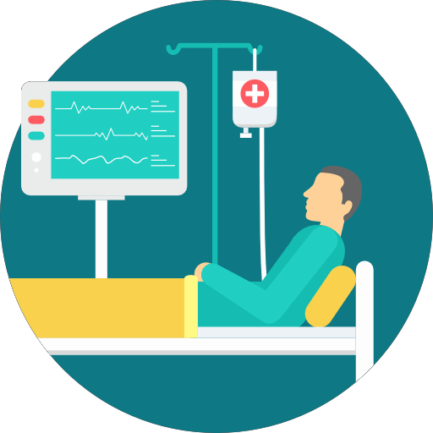
Use Case 3: Patient Data Management: Issues
When it comes to patient data management, there are two main issues in the healthcare industry
First, each patient is unique therefore access to complete medical records is essential in order to adapt the treatment and provide personalized care
Second, sharing information among the medical community is a major challenge

Slide 44
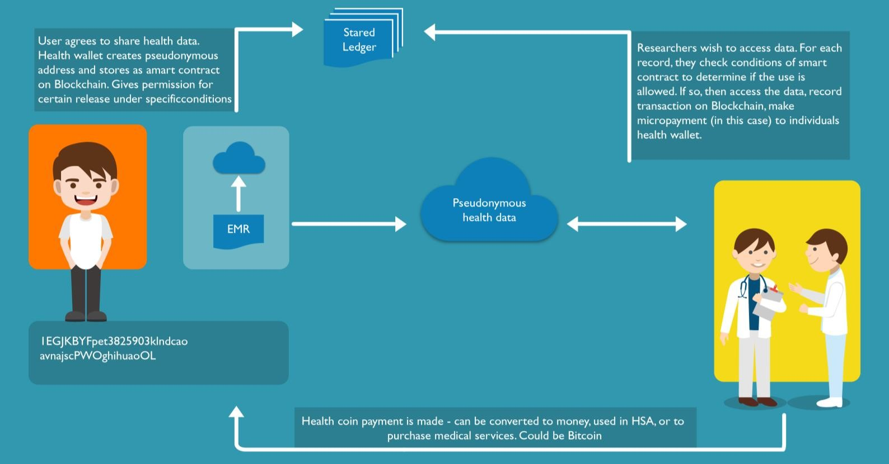
Use Case 3: Patient Data Management: Solution

Slide 45
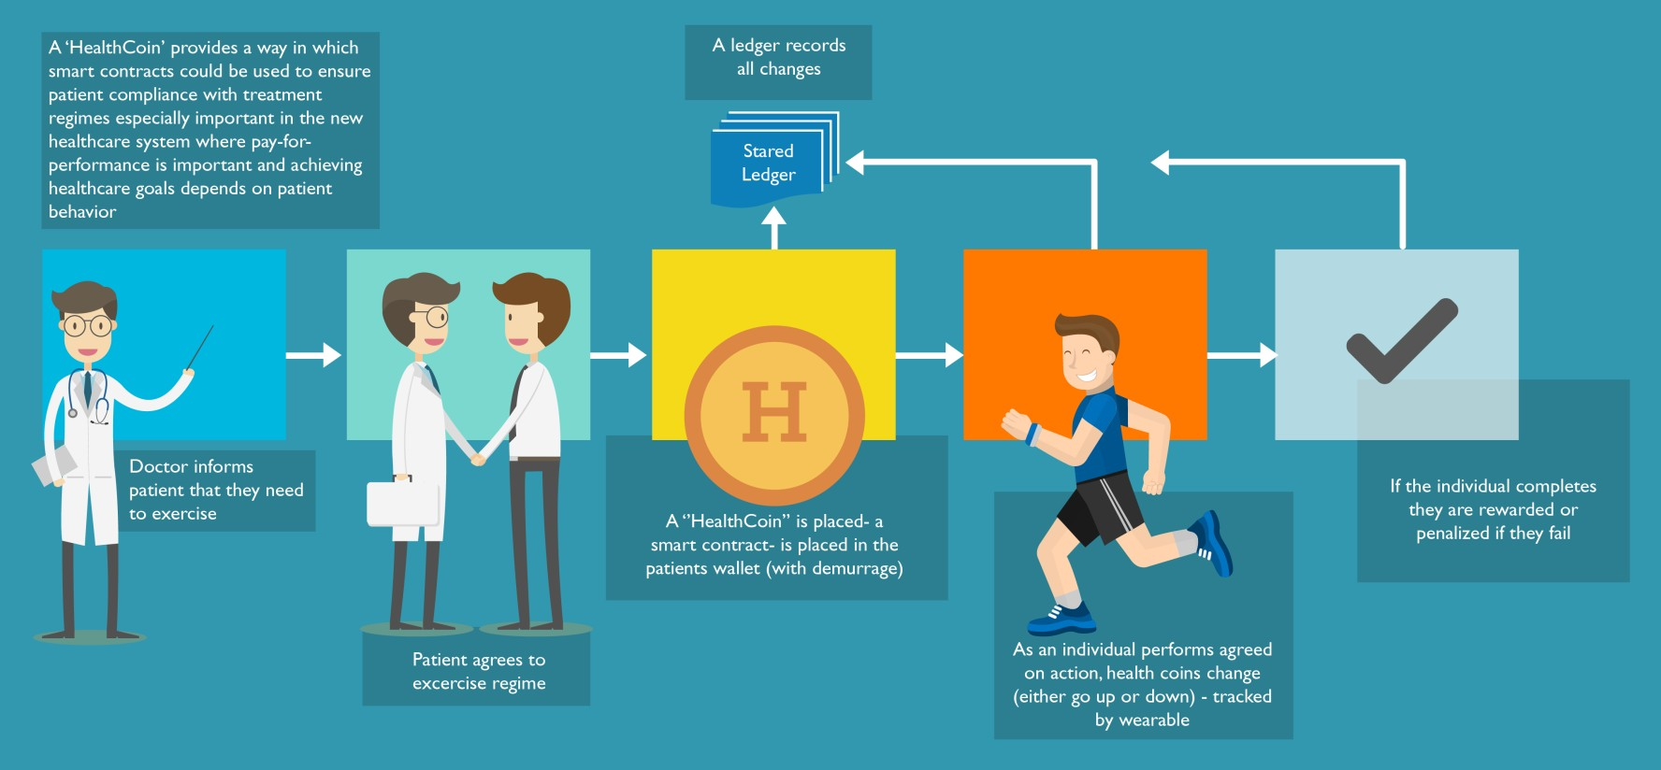
A Healthcoin Ensures Patient Compliance

Slide 46
Let’s see how Blockchain helps in banking sector

Slide 47






Blockchain Use Cases for Banking
In banking there are many existing and developing use cases to implement blockchain: Following are the use cases we will be discussing:
Payments.
1 2
KYC
3
4
Trading Platforms.
Reduction of frauds

Slide 48
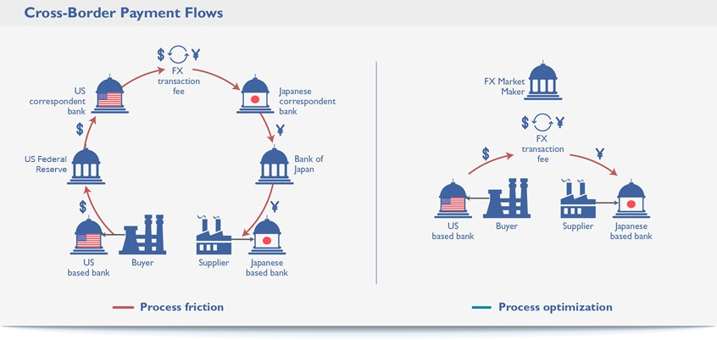
Blockchain Use Cases for Banking: Payments

Slide 49





Blockchain Use Cases for Banking: KYC
By developing compliance platforms and KYC processes on top of blockchain technology, banks can reduce operational costs & also increase the efficiency of compliance processes and develop a closer relationship with the financial regulator
KYC once-performed ,the record will be available as reference for other future transactions as well
KYC of a new customer can be put on a blockchain which can then be used by other banks and other accredited organisations without the need to ask the customer to start the KYC process all over again
As data stored on a blockchain is irreversible, it would provide a single source of truth thereby minimising the risk of duplication or error
There is also the advantage for the customer that they only have to supply KYC documents once

Slide 50
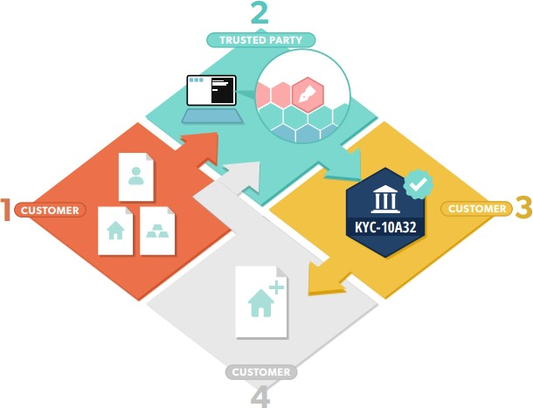
Performing KYC
Acquisition of Personal Information
The Private documents are selectively shared by a customer with a trusted regulator, government entity or licensed partner
01
Title Validation of Personal Information
The trusted party reviews and verifies the authenticity of the documents, then produces a digital signature from the documents’ cryptographic proofs, which is then notarized onto public blockchain
02
KYC Token Issuance
The A cryptographic token is generated for the customer which
can be used to verify the authenticity of the trusted party’s
signature, the documents and thus the validity of each step of the KYC process
Ongoing Updates
With As some documents become obsolete or invalid, a workflow
is introduced and updates are timestamped into a public
blockchain to prove the validation of these documents by a trusted party

Slide 51
Blockchain Use Cases for Banking: Trading Platforms
The traceability and the permanent historic record that would exist on blockchain backing up every asset or item of value that was traded would provide assurance and authenticity all the way through the supply chain
when a high-value item is first created, a corresponding digital token is issued by a trusted central authority which acts to authenticate the product’s point of origin
Every time the product is bought and sold the digital token is moved in parallel so that a real-world chain of ownership is created and mirrored by the blockchain history of that digital token
The digital token is acting as a virtual “certificate of authenticity” which would have the advantage that it is far harder to steal or forge than a piece of paper
The blockchain technology offers a potential new medium to exchange assets without centralised trusts or intermediaries

Slide 52
Blockchain Use Cases for Banking: Reduction of Fraud
Majority of banking systems are built on a centralized database, which makes them more susceptible to cyber-attacks
Also, many banking systems are outdated and are, therefore, more vulnerable to new forms of cyber-attacks
Using blockchain technology, the chance for fraud and data theft can be reduced substantially as the distributed ledger technology secures records
As blockchain is checked at every step of a transaction by independent miners, with all data being open and publicly available, there is a real-time analysis of every bit of data during the transaction
It stores, encrypts and verifies every single bit of data in a transaction
Therefore, should any data breach or fraudulent activity occur, it would be made immediately obvious to all parties who have permission to access the transaction data on the ledger

Slide 53
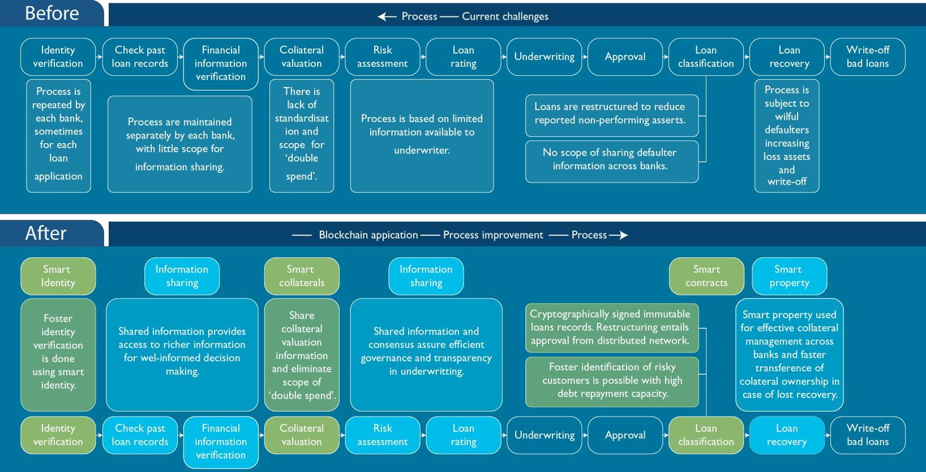
The Modified Loan Management Process

Slide 54
Let’s now understand how Blockchain could be used in Capital Markets

Slide 55
Blockchain Based Capital Market System
Issue with the current Capital markets:
Capital markets have developed a complex global network of interconnected banks and intermediaries that
enable the vast global flow of capital across borders
With each transaction passing through multiple intermediaries each maintaining their own data silos there is duplication of data entry, unnecessary reconciliation errors, inefficient use of capital and delays to settlement
This costs money and creates greater risk
Blockchain has the potential to radically address these issues, with the potential for the elimination of intermediaries and reduction in settlement times

Slide 56
Why Blockchain Seems Promising in Capital Markets
“Distributed ledger technology could reduce banks” infrastructure
“Has the potential for modernizing, streamlining and simplifying the siloed design of the financial industry
infrastructure with a shared fabric of common information”
“SETL is to work with Computershare on a joint initiative to establish securities ownership registers using distributed ledger technology for Australia”
Over $1 billion invested in blockchain companies since the technology’s creation in 2009, with a 59% increase in the last year

Slide 57
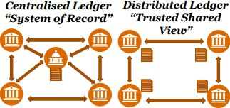
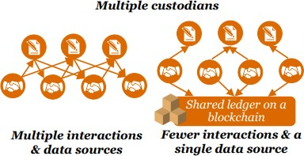
How Blockchain Could be Applied in Capital Markets
Many of our clients are exploring blockchain’s potential to disintermediate, increase speed and reduce cost whilst increasing resilience in their businesses. Here are some examples of blockchain’s business applications…
Settlements:
By removing intermediaries and providing a trusted and
shared view of permissioned data, blockchain could:
Reduce costs (e.g. fewer reconciliation errors)
Speed up settlement (e.g. faster validation)
Increase resilience (e.g. no single point of failure)
Improve transparency (e.g. easier to monitor)
Collateral Management
By enabling faster settlement and a shared, trusted view
of asset information, blockchain could:
Solve new collateral requirements
Allow you to tap into unused assets
Cut operational complexity and costs
Increase flexibility

Slide 58
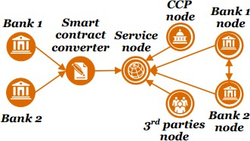
How Blockchain Could be Applied in Capital Markets…
Confirmations:
By creating a smart contract on a blockchain confirmed lifecycle contracts could be automated, enabling:
Increase trust and transparency (e.g. with a golden
common data source)
Reduce costs (e.g. reduced data entry duplication and reconciliation errors)
Reduce operational risk
Better measurement of contingent risk

Slide 59
Blockchain in Government
Let’s See how blockchain can help the governments around the world

Slide 60



How will Blockchain Transform Government?
Inefficiency and lack of transparency and accountability are endemic to government operations. Blockchain can enable a more free, fair and accountable governance. Blockchain can provide the following:
Provide transparency and accountability in an effort to eliminate waste, fraud, or misappropriation of finding
Facilitate in providing aid to programs, states or other nations and ensure said funds reach the intended recipients
Enable a more streamlined and accurate auditing
process
Provide a digital ledger system for things such as property, taxes, public services and utilities
06
03
Supply chain management and
auditing for the military
Enable open and fair elections, by ensuring the integrity of the system and its results

Slide 61
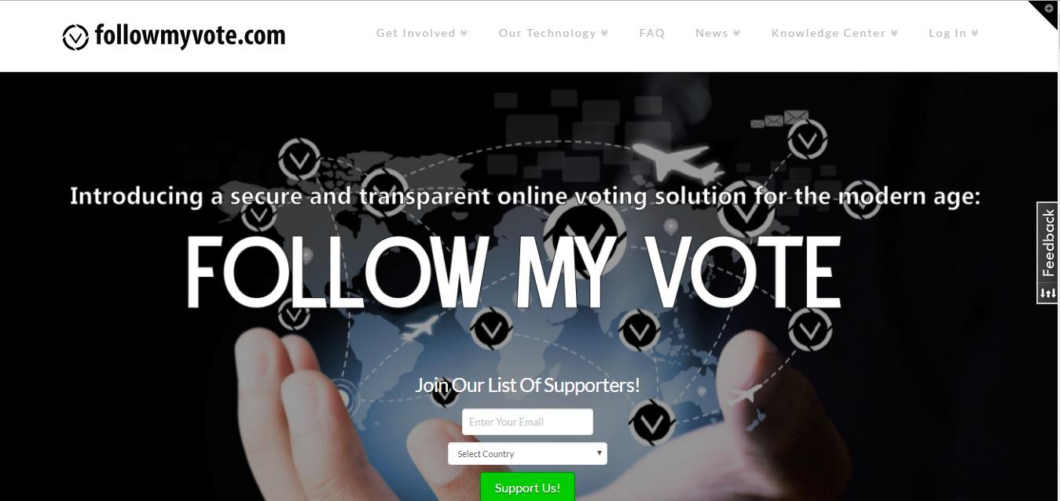
Online Voting: Securing Elections Using Blockchain

Slide 62
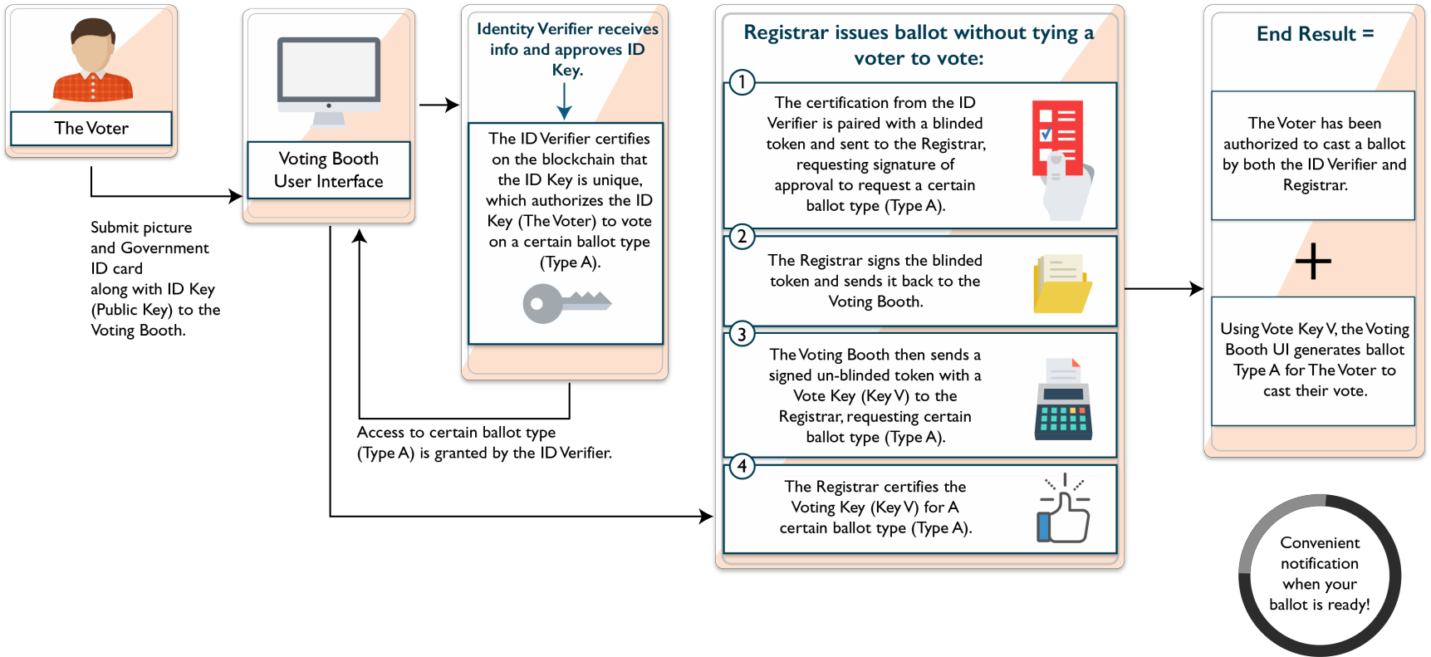
Follow My Vote

Slide 63
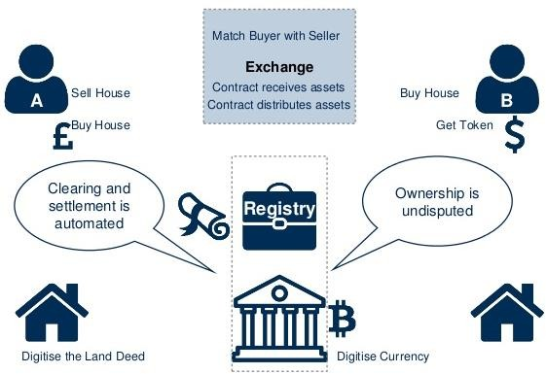
Registering Land
The plan is to use the technology to make the details of real estate transactions visible to all parties – banks, brokers, government officials, buyers and seller
Reduce risk of manual errors
Create Secure process for transferring documents
Verify identity of users

Slide 64
Real Estate
Pain points for buying and selling property include: a lack of transparency during and after transactions, copious amounts of paperwork, possible fraud, and errors in public records to name just a few
Blockchain offers a way to reduce the need for paper-based record keeping and speed up transactions
Real estate blockchain applications can help record, track, and transfer land titles, property deeds, liens etc and helps ensure the documents are accurate and verifiable
Ubitquity offers a platform for financial institutions, title, and mortgage companies and aims to secure documents, while enhancing transparency and reducing costs

Slide 65
Devising Public Policy
Information sharing, creation and collaboration through blockchain application
An online policy forum through which government can collaborate with citizens in the formulation of policies
This shall also include decisions like, allocating budgets across all sectors, deciding on tax brackets, devising social welfare plans, enhancing infrastructure, education system planning etc
Benefits:
Governments could benefit by gleaning insights and suggestions from citizens
A collaborative approach for viable governance solutions would lead to better policy outcomes
Transparency created by blockchain based voting across different choices of policies shall lead to integrity in the Governance

Slide 66
Governments Around the World are Using Blockchain
Let’s look at how governments around the world are taking the first steps in adopting distributed ledger technology with various Blockchain initiatives

Slide 67
Georgia – Blockchain Land Registry
The government of Georgia is using blockchain to register land titles and validate property-related government transactions.
A custom-designed blockchain system has been integrated into the digital records system of the National Agency of Public Registry (NAPR), and anchored to the Bitcoin blockchain through a distributed digital timestamping service
The digital timestamping service allows the government to verify and sign a document containing a citizen’s essential information and proof of ownership of property
The system will boost land title transparency, reduce the prevalence of fraud, and bring significant time and cost savings in the registration process

Slide 68
Estonia –Identity Management, E-voting, (E.H.R.)
Estonia citizens and e-residents are issued a cryptographically secure digital ID card powered by blockchain infrastructure on the backend, allowing access to various public services
On a blockchain platform, citizens can verify the integrity of the records held on them in government
databases and control who has access to them
Nasdaq successfully completed a trial in Estonia that will enable company shareholders to use a blockchain voting system
Estonia is also adopting blockchain technology to secure the country’s 1 million health records
Every update and access to healthcare records is registered on the blockchain, preventing medical fraud

Slide 69
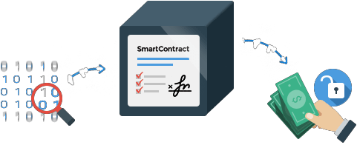
Delaware, USA – Smart Contracts, Public Archives
Blockchain technology will be used to store contracts and other corporate data on a distributed ledger, allowing companies and agencies to store their documents in more than one location
This will keep them more secure and allow automated access by constituents, shareholders and employees
The use of blockchain means the documents are can be replicated in multiple locations, providing better disaster recovery and saving the cost of off-site physical storage

Slide 70


Dubai Plans Digital Passports Using Blockchain Tech
The Dubai government has partnered with UK start-up ObjectTech to bring blockchain-based security to the emirate's airport
According to the start-up, the system combines biometric verification and blockchain technology, and will use a “pre-approved and entirely digitized passport” to authorize passengers' entrance into the country
The system will further verify individuals through a three-dimensional scan via a short tunnel as they walk from the aircraft to claim their baggage
the digitized passport will incorporate a feature called 'self-sovereign identity' for privacy protection, which it claims allows passengers
to control which parties can view their passport information

Slide 71
There are a Plethora of Use Cases of Blockchain
Understanding which use cases you should pursue requires business understanding and technology knowledge, including:
Your business strategy and process
The parties that must interact to deliver benefit
Technology provider landscape
Regulatory restrictions and requirements
Blockchain is an exciting new technology with huge potential to disrupt and improve
numerous industries

Slide 72

Blockchain Use Cases across various Domains

Slide 73

Real World Use Cases of Blockchain

Slide 74








Slide 75


Copyright © 2017, edureka and/or its affiliates. All rights reserved.

Slide 76

Copyright © 2017, edureka and/or its affiliates. All rights reserved.

Slide 77


